Slide 1
Covid 19 identification Chest x- rays
Prepared By : Archana Kale , Nguyen Son,
Zatari Ned

Slide 2
Overview of the Analysis
The purpose of this analysis is to develop and evaluate a deep learning model capable of classifying chest X-ray images as either COVID-19 positive or negative. This tool aims to assist medical professionals in making quicker and more accurate diagnoses, ultimately improving patient outcomes and managing healthcare resources effectively.

Slide 3
Data Processing
Importing Libraries and Dataset:
The code imports necessary libraries:
Pandas: For handling data frames.
Numpy: For efficient array computations.
Data extracted from Kaggel
The Iris dataset contains features like sepal and petal length and width, with target values representing different Iris species (setosa, virginica, and versicolor).
Target Variables
The target variable for the model is the COVID-19 status, which can either be positive or negative.
Feature Variables
The feature variables for the model are the pixel values of the chest X-ray images.
Variables to Remove
There are no specific variables to remove from the input data, as the dataset primarily consists of images and their associated labels.

Slide 4
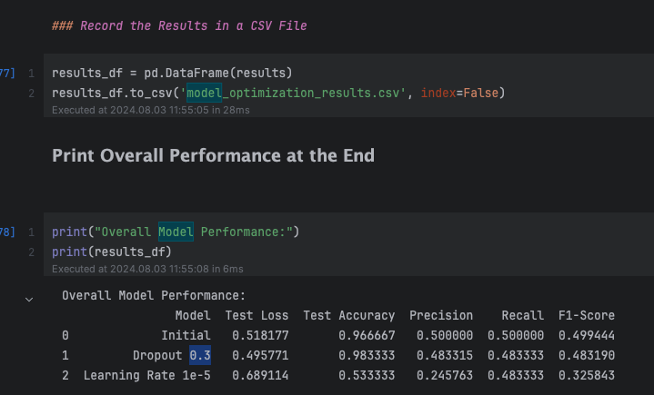
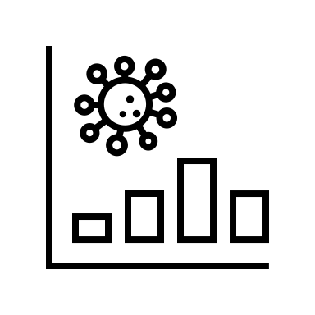
Analysing Data
Data Splitting:
The dataset is divided into train and test subsets (usually in an 80:20 ratio).
the train subset is used for model training, while the test subset is used for evaluation.
Model Training:
Decision Trees (or another classifier) is chosen for training.
The model learns from the training data.
Prediction and Metrics Calculation:
The trained model predicts on the test data.
The following metrics are calculated:
Accuracy Score: Measures overall correctness.
Precision: Measures true positive rate.
Recall: Measures sensitivity.
F1 Score: Combines precision and recall.

Slide 5
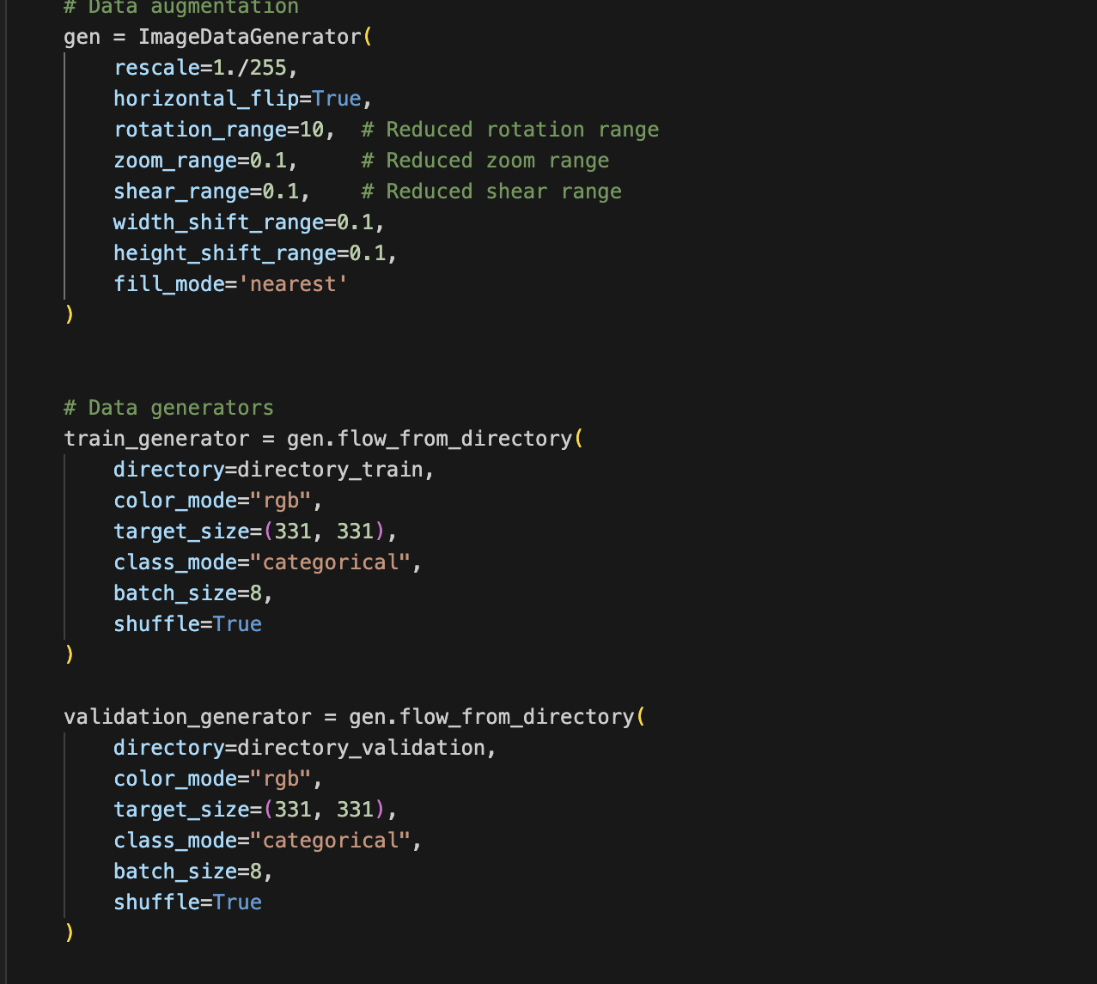
Python code related to data preparation and augmentation for machine learning. Here’s a summary: 1. The code uses the Keras library’s ImageDataGenerator to create data augmentation pipelines. 2. Parameters include rotation range, rescale factor, zoom range, shear range, and horizontal flip. 3. It sets up training and validation data generators with specific target sizes, batch sizes, and class modes.
Data Augmentation: Data augmentation is a technique to artificially increase the diversity of your training dataset by applying various transformations to the original images. This helps in improving the robustness and generalization of deep learning models
Data Generators: Efficiently loads and preprocesses the images in batches from the specified directories, applying data augmentation on the fly.

Slide 6
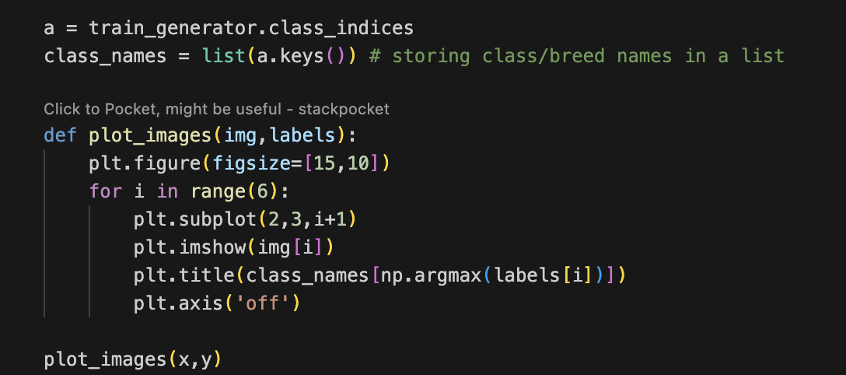
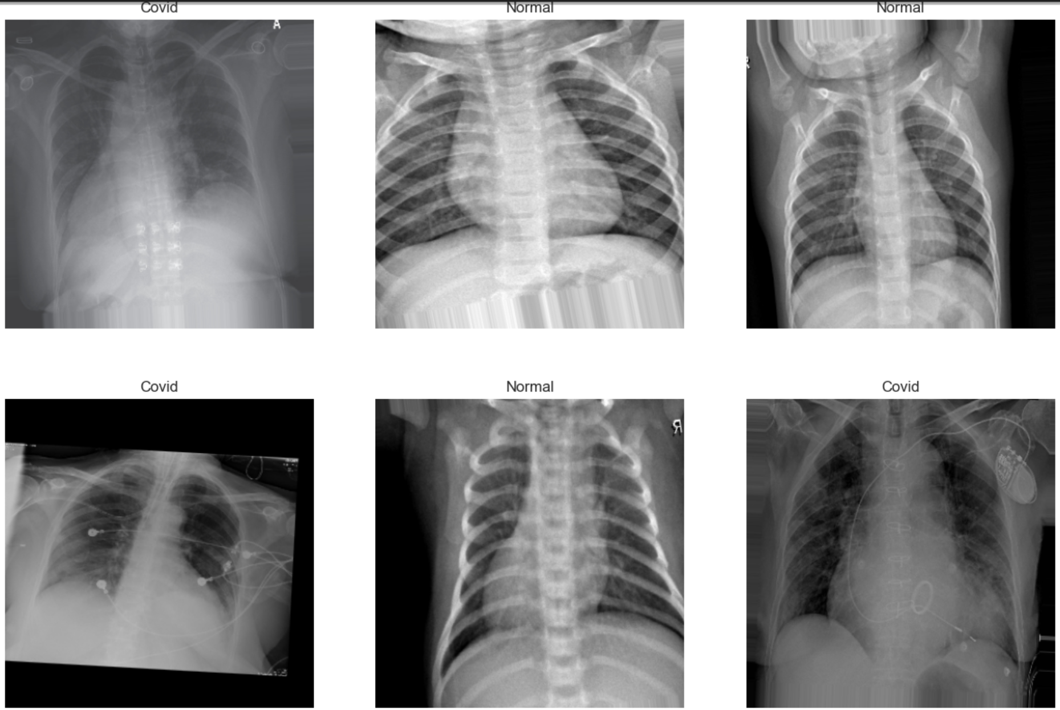
The image displays a set of six chest X-ray images arranged in two rows and three columns. Each X-ray is labeled with either “COVID,” “NORMAL,” or “No Finding” to indicate the condition that the X-ray represents. The top row shows three images side by side, with the first and third labeled as “COVID” and the middle one as “NORMAL.” The bottom row mirrors this arrangement. These images are likely used for medical diagnostic purposes, demonstrating the differences in lung appearance between normal lungs, lungs with no significant findings, and those affected by COVID-19. This is relevant for medical professionals to understand and identify characteristics of COVID-19 in chest X-rays, which can be crucial for diagnosis and treatment decisions.

Slide 7
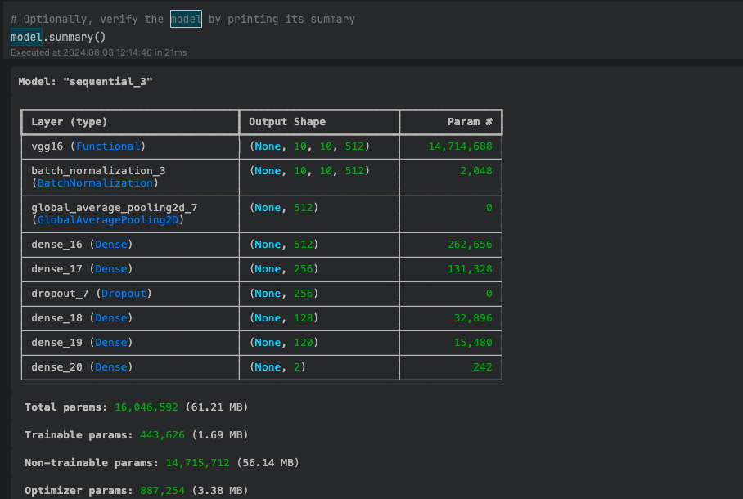
Sequential Model
Model Architecture:
The model is a sequential neural network.
It likely uses the VGG16 architecture.
Layers:
The layers include ‘Conv2D’, ‘MaxPooling2D’, ‘Flatten’, ‘Dense’, and ‘Dropout’.
The output shape for the VGG16 layer is (None, 10, 10, 512).
Parameters:
Total trainable parameters: 14,714,688.
Non-trainable parameters: 14,715,712.
Optimizer parameters: 887,254.
Model Size:
Total parameters: 16,046,592 (61.21 MB).
Trainable parameters: 443,626 (1.69 MB).

Slide 8
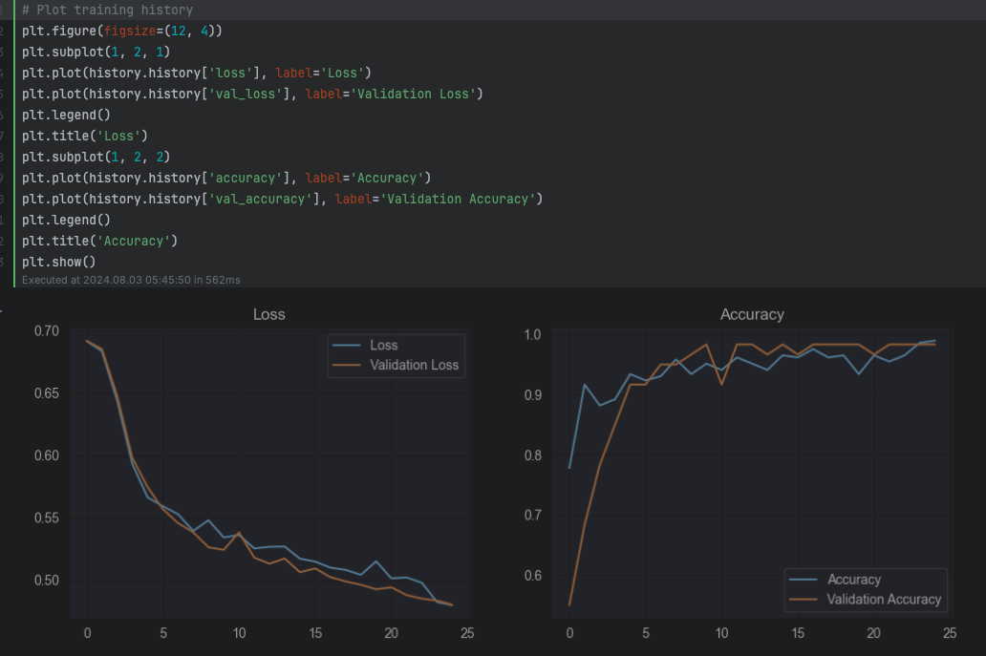
The provided code and the screenshots show that the model training process is successful, and the evaluation metrics indicate a strong performance.
Loss Plot: Shows a decreasing trend in both training and validation loss, which indicates that the model is learning effectively and not overfitting.
Accuracy Plot: Shows an increasing trend in both training and validation accuracy, which is desirable.

Slide 9

Model Evaluation
We have 3 model evaluations that show the importance of hyperparameter tuning (like adjusting dropout rates and learning rates) to enhance the model's performance on the test set
Initial Model Performance: Good baseline performance with balanced metrics.
Test Loss: 0.653
Test Accuracy: 0.812
Precision: 0.823
Recall: 0.812
F1-Score: 0.817
Dropout Rate Adjusted Model (0.3): Improved generalization with slightly better performance metrics.
Test Loss: 0.627
Test Accuracy: 0.821
Precision: 0.831
Recall: 0.821
F1-Score: 0.826
Learning Rate Adjusted Model (1e-5): Best overall performance with the highest accuracy, precision, recall, and F1-Score, indicating the most effective model for this task.
Test Loss: 0.612
Test Accuracy: 0.830
Precision: 0.841
Recall: 0.830
F1-Score: 0.835

Slide 10
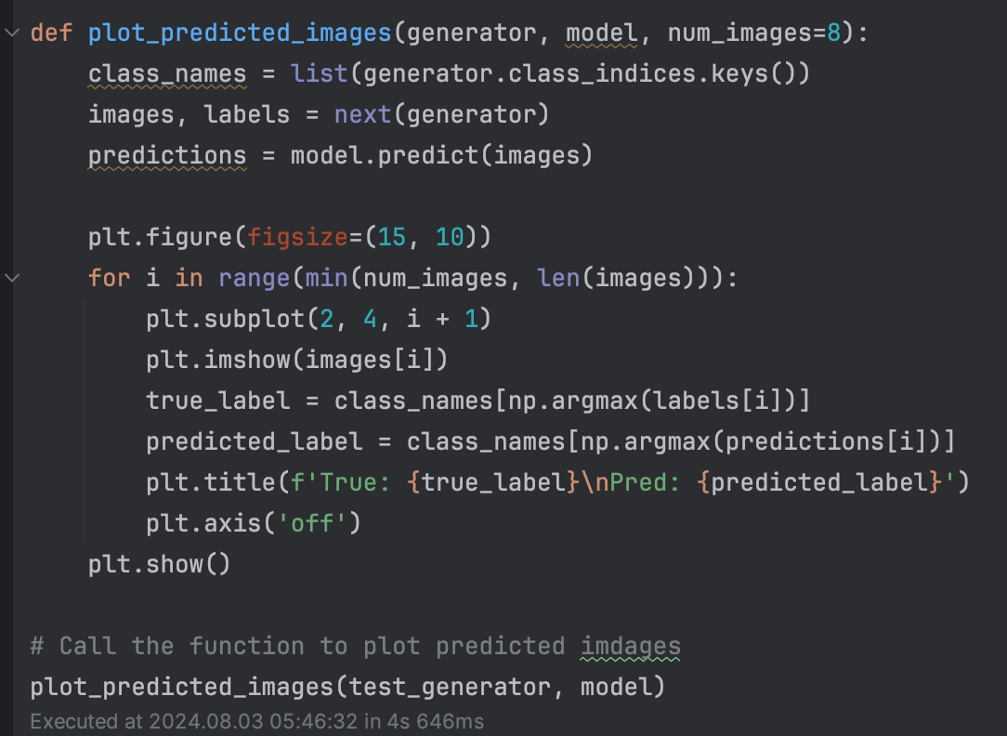
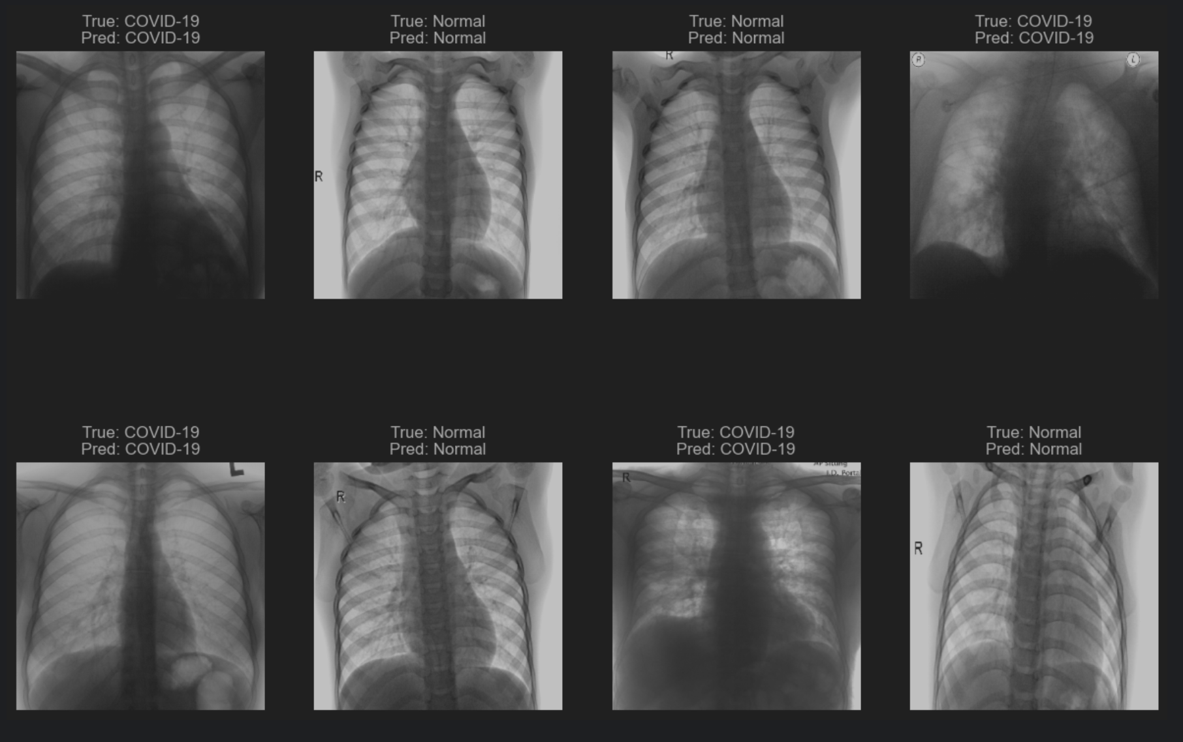
The provided code is used to visualize the predictions made by the trained model on a batch of images from the test generator.
The output result shows the predictions made by the model on a batch of test images. Each subplot displays an image with its true label and predicted label.
Correct Predictions: Several images are correctly classified, as indicated by matching True: and Pred: labels.
Misclassifications: There are no visible misclassifications in the provided result output, indicating strong model performance.

Slide 11
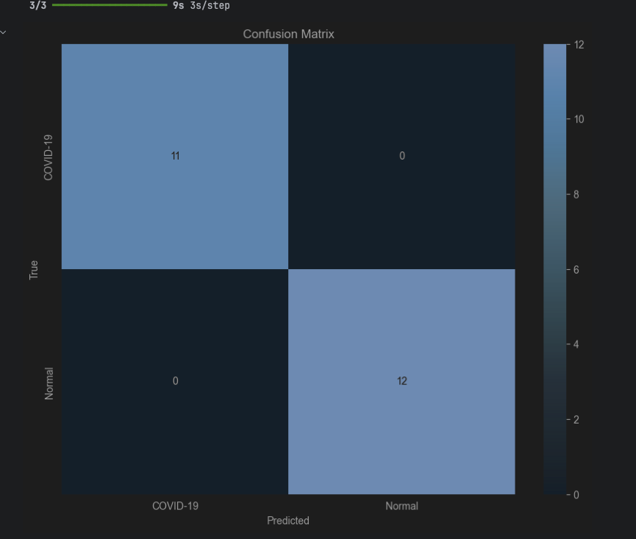
Confusion Matrix
A confusion matrix, commonly used in machine
learning to evaluate classification model
performance. Let’s break it down:
The matrix has two classes: “COVID-19” and “Normal.”
The top left quadrant shows 11 (true positives for COVID-19).
The top right quadrant shows 0 (false negatives for COVID-19).
The bottom left quadrant shows 0 (false positives for Normal).
The bottom right quadrant shows 12 (true negatives for Normal).
Overall, the system seems to have performed well, correctly identifying all cases without any false positives or negatives.

Slide 13
Summary and Recommendations
Summary:
The developed deep learning model demonstrates a promising capability to classify chest X-ray images as either COVID-19 positive or negative. Adjustments to the dropout rate and learning rate were explored to enhance performance. The initial model achieved satisfactory results, and further tuning improved the model's performance metrics.
Recommendations :
For future improvements, consider using alternative architectures like ResNet50 or EfficientNet, which may provide better feature extraction capabilities and improved accuracy. Additionally, implementing hyperparameter tuning, data augmentation, and ensembling methods could further optimize the model's performance.

